Slide 1


Audio fundamentals
LP—Audio and Video system
basic of microphone, its characteristics

Slide 2
What is audio
Audio system – system consists of 1) Micro phone , 2) Amplifier , 3) speaker
system reproduce the audio signal similar to original signal .

Slide 3
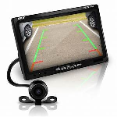
Video system- system consists of 1) Camera , 2) Amplifier , 3) display unit
system reproduce the video signal on display

Slide 4
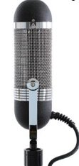



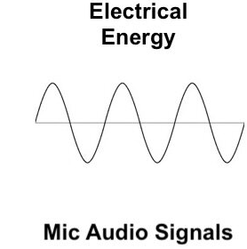
Microphone
Definition – it is transducer , which is used to convert sound wave in to electrical signal.
Mic may be wired or wireless is called converter

Slide 5
Electrical signal (V/I)– it having ,Amplitude ,frequency , phase.
This characteristics can determine specification of MIC
Mic o/p connection wire can be connected to CRO
So audio frequency rang was 20 Hz to 20KHz
Use in – Recording and transmitting sound

Slide 6
characteristics of microphone
sensitivity
frequency response
signal to noise ratio
Distortions
Directivity
Output impedance
Polar diagram
Dimension and weight
Current consumption

Slide 7
Sensitivity – it is called output voltage of microphone. Range was max 20mv.
Frequency response – band width or frequency range over sound voltage gain made constant with different freq.
Output impedance – which represent in ohms. microphone and recorder impedance must match. To remove the amplitude and frequency effect imp match is required high quality microphone has impedances low

Slide 8
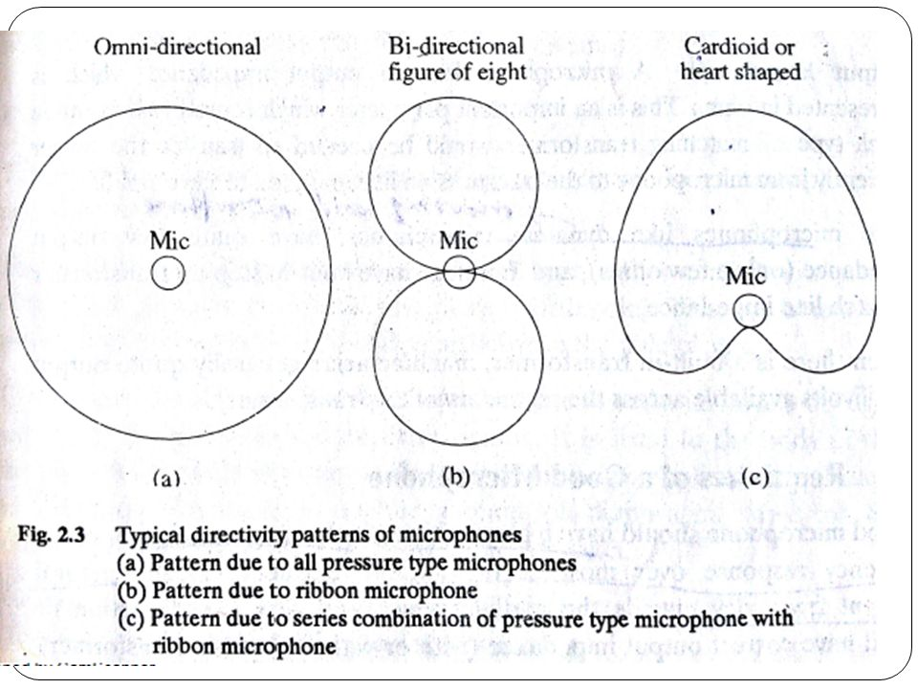
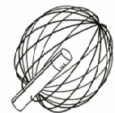
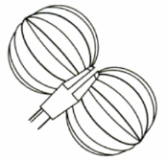
directivity – tell that, how the forces of sound wave was applied to microphone, like
omnidirectional , bidirectional , cardiod
omnidirectional
Figure of 8

Slide 9
Requisites of good microphone
high sensitivity
high signal to noise ratio
flat frequency response
low distortions
Correct o/p imp

Slide 10
Static microphone – crystal , capacitor
Dynamic microphone – Ribbon , moving coil
Wire microphone
Wireless microphone
Question -----
Thank u ----

